Slide 1
Process Models
主讲：王湖南 wanghunan@scu.edu.cn
Ref: Chapt. 2、3、4

Slide 2
Chapter Overview
What? A software process - a series of predictable steps that leads to a timely, high-quality product.
Who? Managers, software engineers, and customers.
Why? Provides stability, control, and organization to an otherwise chaotic activity.
Steps? A handful of activities are common to all software processes, details vary.
Work product? Programs, documents, and data.
Correct process? Assessment, quality deliverable.

Slide 3
Software Engineering
1. Software Engineering:
The establishment and use of sound engineering principles in order to obtain economically software that is reliable and works efficiently on real machines.
- Fritz Bauer, 1969, NATO

Slide 4
Software Engineering
2.Software Engineering studies how to produce software that:
Meets user requirements
  Why software projects fail?
Works correctly and reliably
  Produces correct results for all circumstances
  System fails gracefully
  System is secure (esp. important in web-based environment)

Slide 5
Software Engineering
Is easy to
  Use (GUI)
  Maintain (i.e. modify and upgrade) to meet user changing needs
Is delivered on time
Is within budget
(optional but gaining importance) Modules can be reused

Slide 6
Software Engineering
Why do software projects fail? Factors %
1. Incomplete Requirements 13.1%
2. Lack of User Involvement 12.4%
3. Lack of Resources 10.6%
4. Unrealistic Expectations 9.9%
5. Lack of Executive Support 9.3%
6. Changing Requirements & Specifications 8.7%
7. Lack of Planning 8.1%
8. Didn‘t Need It Any Longer 7.5%
9. Lack of IT Management 6.2%
10. Technology Illiteracy 4.3%
11. Others 9.9%
Source: Standish Group 1995

Slide 7
Software Engineering
3.Software Engineering :Designing, building and maintaining large software systems
- I. Sommerville

Slide 8
Software Engineering
4. Software Engineering:
The application of a systematic, disciplined, quantifiable approach to the development, operation, and maintenance of software; that is, the application of engineering to software.
The study of approaches as in (1).
- IEEE Standard 610.12-1990

Slide 9
A Layered Technology
Software Engineering
tools
methods
process model
a “quality” focus

Slide 10
A Process Framework
Software process
Process framework
Umbrella activities
framework activity #1
framework activity #2
SE action #1.1
SE action #2.1
task sets | ⎧ ⎨ ⎩ | work tasks work products QA points milestones
task sets | ⎧ ⎨ ⎩ | work tasks work products QA points milestones
SE action #1.2
SE action #2.2
task sets | ⎧ ⎨ ⎩ | work tasks work products QA points milestones
task sets | ⎧ ⎨ ⎩ | work tasks work products QA points milestones

Slide 11
Framework Activities
Communication
Planning
Modeling
  Analysis of requirements
  Design
Construction
  Code generation
  Testing
Deployment

Slide 12
Umbrella Activities
Software project management
Formal technical reviews
Software quality assurance
Software configuration management
Work product preparation and production
Reusability management
Measurement
Risk management

Slide 13
The Process Model: Adaptability
The framework activities will always be applied on every project ... BUT
The tasks (and degree of rigor) for each activity will vary based on:
  the type of project
  characteristics of the project
  common sense judgment; concurrence of the project team

Slide 14
Process Models

Slide 15

Outline
Introduction
The Waterfall Model
Incremental Process Models
Evolutionary Process Models
Specialized Process Models
The Unified Process
Agile
DevOps 软件开发模式

Slide 16
Introduction
What is process model?

Slide 17

Software process model
Attempt to organize the software life cycle by
  defining activities involved in software production
  order of activities and their relationships
Goals of a software process
  Standardization
  Predictability
  Productivity
  high product quality
  ability to plan time and budget requirements

Slide 18

How to develop software? Code & Fix
The earliest approach
Write code
Fix it to
  eliminate any errors that have been detected,
  to enhance existing functionality, or
  to add new features
Source of difficulties and deficiencies
  impossible to predict
  impossible to manage

Slide 19
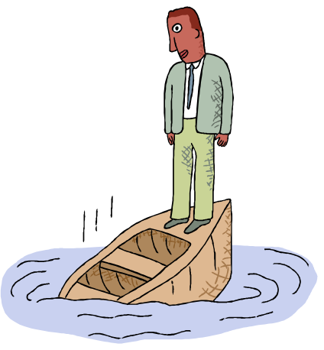
Models are needed
Software crisis
  scheduled time and cost exceeded
  user expectations not met
  poor quality
The size and economic value of software applications required appropriate "process models"

Slide 20

What is Process model?
Determine the order of stages involved in software development and evolution;
Establish the transition criteria for progressing from one stage to the next;
Addresses the following software project questions:
  What shall we do next?
  How long shall we continue to do it?"
(B. Boehm 1988)

Slide 21
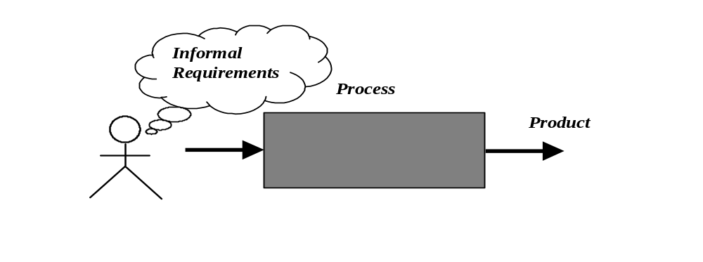
Process as a "black box"
Quality?
Uncertain /
Incomplete
requirement
In the beginning

Slide 22

Problems
The assumption is that requirements can be fully understood prior to development
Interaction with the customer occurs only at the beginning (requirements) and end (after delivery)
Unfortunately the assumption almost never holds!

Slide 23
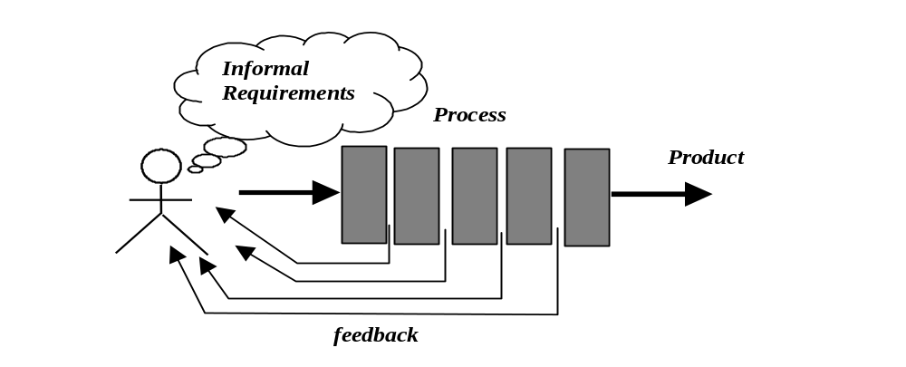
Process as a "white box"

Slide 24

Advantages
Reduce risks by improving visibility
Allow project changes as the project progresses
The changes based on feedback from the customer

Slide 25

The main activities of software production
They must be performed of the model independently
The model simply affects the flow among activities

Slide 26
The Waterfall Model
Classic Life Cycle Model

Slide 27
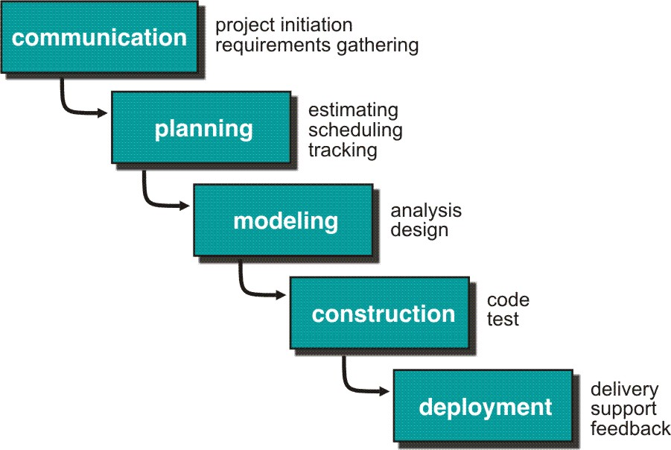
The Waterfall Model
Pro: the most widely used model; a template for use
Con: inflexible to changing customer requirements
This is a good model to use when requirements are well understood

Slide 28
The Waterfall Model discussion
Assumes that a complete system will be delivered after the linear sequence is completed
Problems:
  customer has to state all requirements explicitly;
  doesn’t support change;
  customer can see a working version of the program until code phase.

Slide 29

Why does it fail sometimes?
Real projects rarely follow the sequential flow that the model proposes;
It is often difficult for the customer to state all requirements explicitly;
The customer must have patience.

Slide 30

Process for Offshore?
Analysis
Design
Construct
System test
Accept. test
Deploy

Slide 31
The V Model
If we rely on testing alone, defects created first are detected last
User
Need
Product
Release
System
Requirements
system test plan
System
Testing
Software
Requirements
software test plan
Software
Testing
integration plan
Software
Design
Integration
Testing
unit plan
Software
Implementation
Unit
Testing
time

Slide 32
Incremental Process Models

Slide 33
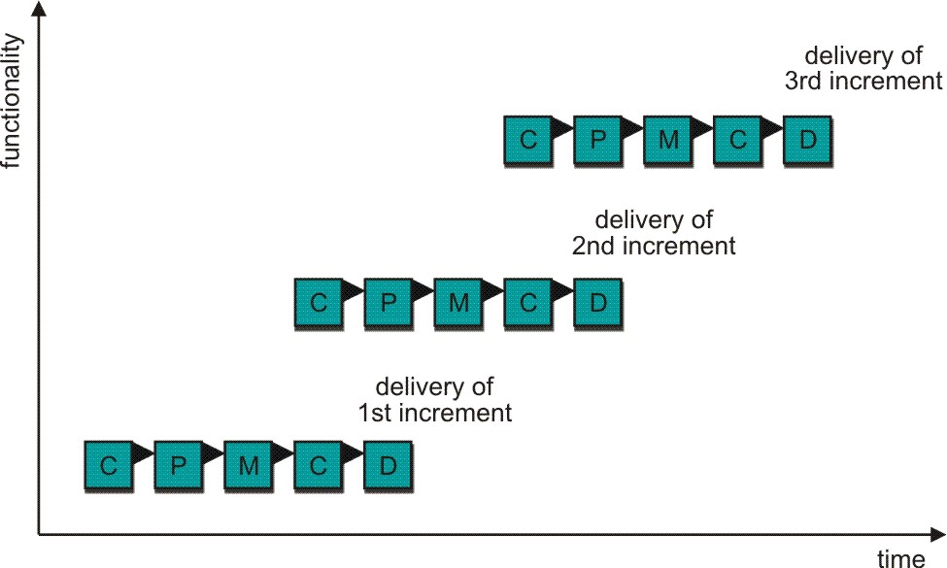
Incremental model
delivers software in small but usable pieces, each piece builds on pieces already delivered

Slide 34
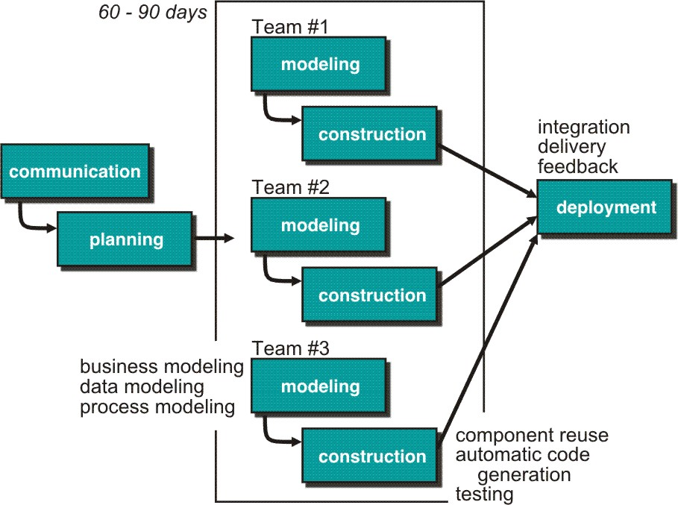
RAD Model
makes heavy use of reusable software components with an extremely short development cycle

Slide 35
The RAD Model discussion
The RAD model is a high-speed adaptation of the linear sequential model. Project requirements must be well understood and the project scope tightly constrained
Developers can use component-based construction techniques to build a fully functional system in a short time period
Pro: may shorten development time significantly
Con: the system may not be modularized; performance issue; risk issue

Slide 36
Evolutionary Process Models

Slide 37
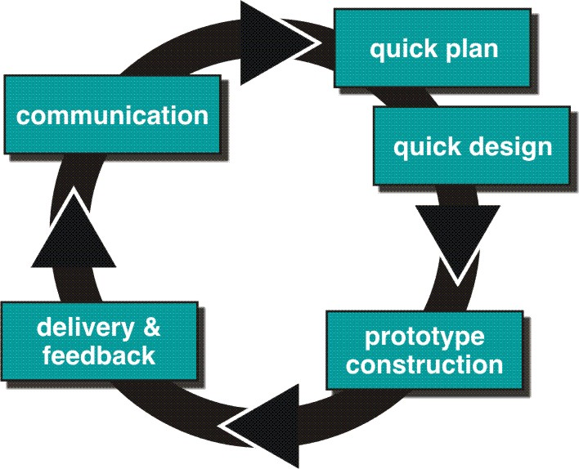
Prototyping
good first step when customer has a legitimate need, but is clueless about the details, developer needs to resist pressure to extend a rough prototype into a production product

Slide 38
The Prototyping Model
This model is good to use when the customer has legitimate needs, but is not able to articulate the details at the start of the project. A small mock-up of a working system is developed and presented to the customer.
Pro: evaluated by user and used to refine requirements
Con: the first system built is barely usable; unrealistic expectations from the customer; the performance issue

Slide 39
The Prototyping Model discussion
Designed to assist the customer or developer in understanding requirements.
Quick design (focus on representation of software aspects visible to the user)
Prototype is evaluated by the customer, and used to identify and refine requirements
Prototype is discarded (at least in part)

Slide 40
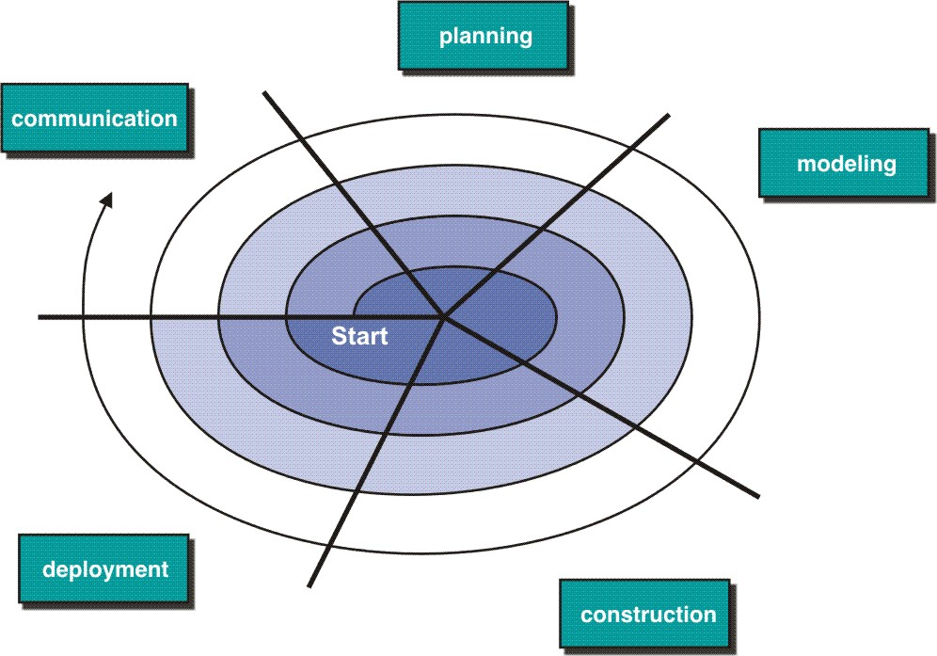
The Spiral Model
couples iterative nature of prototyping with the controlled and systematic aspects of the linear sequential model

Slide 41

Distinguishing Features
A cyclic approach for incrementally growing a system’s degree of definition and implementation while decreasing its degree of risk;
A set of anchor point milestones for ensuring stakeholder commitment to feasible and mutually satisfactory system solutions.

Slide 42
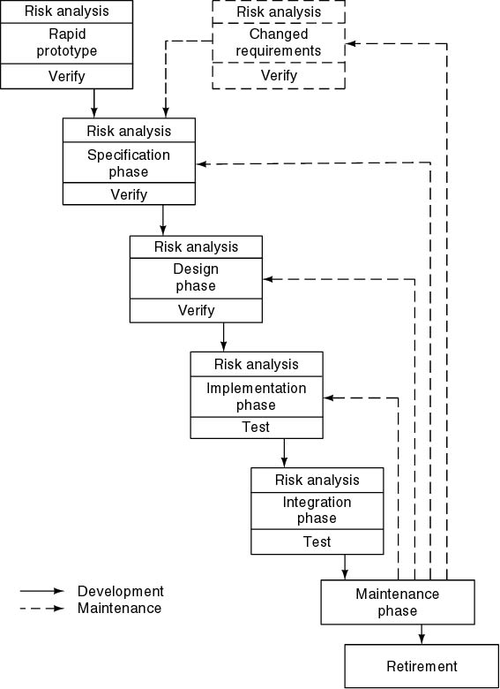
Spiral Model
Simplified form
  Waterfall model plus risk analysis
Precede each phase by
  Alternatives
  Risk analysis
Follow each phase by
  Evaluation
  Planning of next phase

Slide 43
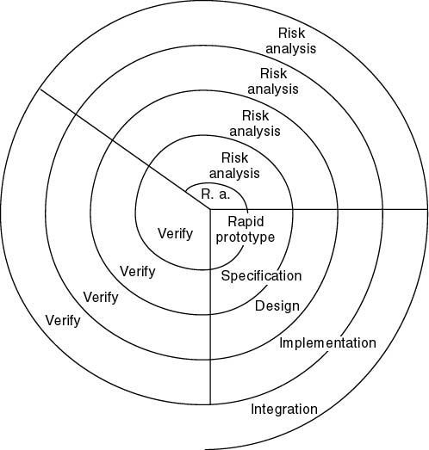
Simplified Spiral Model
If risks cannot be resolved, project is immediately terminated

Slide 44
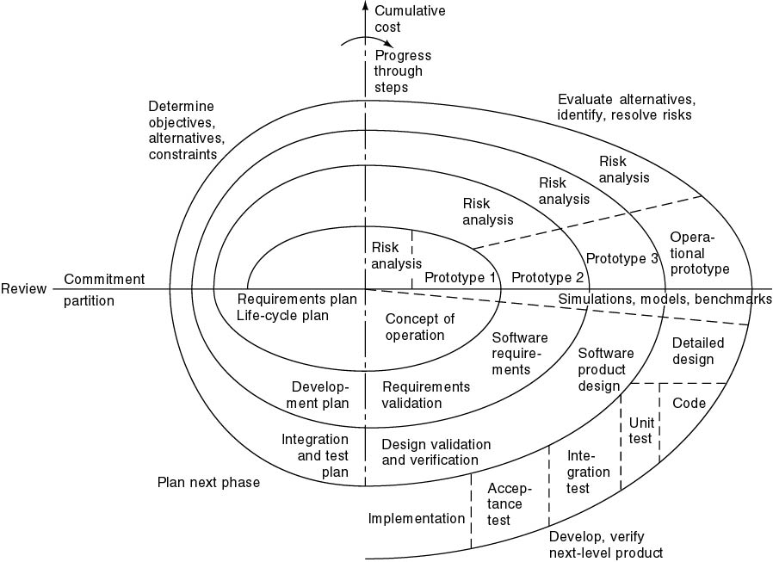
Full Spiral Model (contd)

Slide 45

Analysis of Spiral Model
Strengths
  Easy to judge how much to test
  No distinction between development, maintenance
Weaknesses
  For large-scale software only
  For internal (in-house) software only

Slide 46
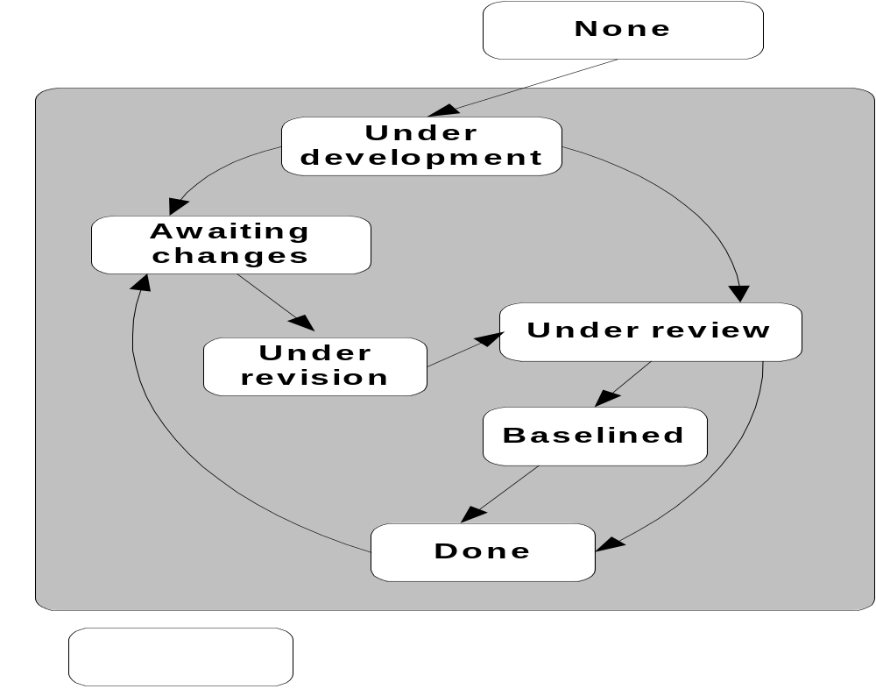
The Concurrent（并行） Process Model

Slide 47

Concerns（担忧） of Evolutionary Software Process
Prototyping poses a problem to project planning because of the uncertain number of cycles required to construct the product;
Evolutionary software processes do not establish the maximum speed of the evolution;
Software processes should be focused on flexibility and extensibility rather than on high quality;

Slide 48
Specialized Process Models

Slide 49
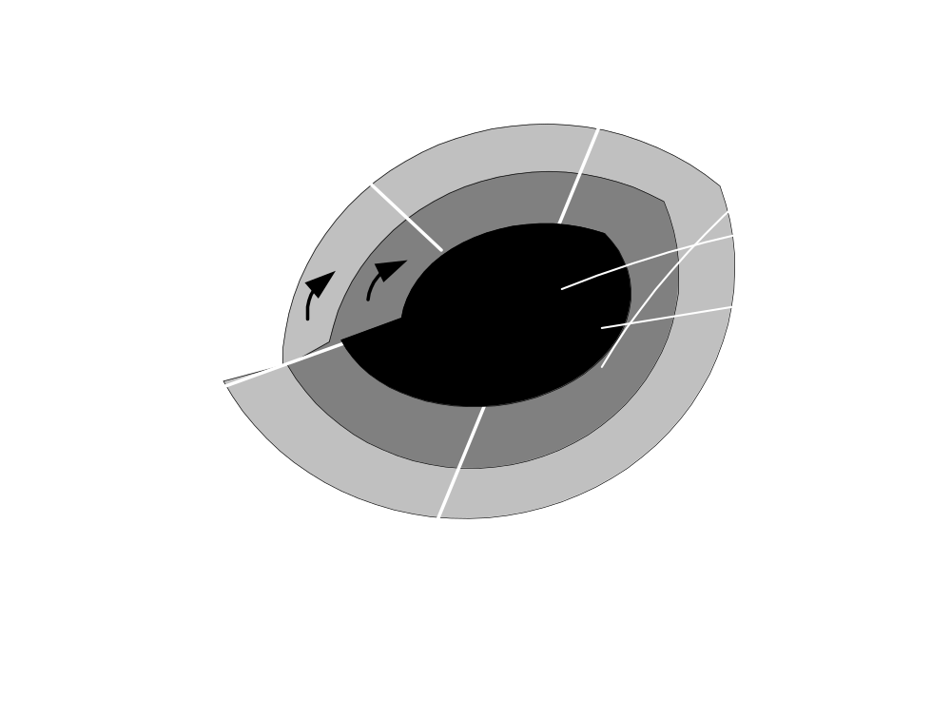
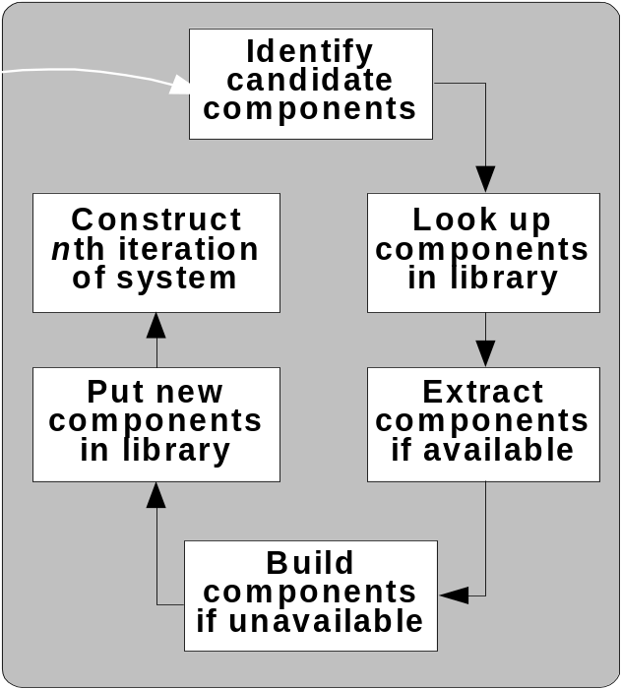
Component-Based Development
The Component-Based Development
Software Reuse（软件重用）!

Slide 50

Formal Methods Model（形式化方法）
Emphasizes the mathematical specification of requirements
Rigorous mathematical notation used to specify, design, and verify computer-based systems

Slide 51

Why are they not widely used?
The development of formal models is time-consuming and expensive;
Extensive developers training is required;
It is difficult to use the models as a communication mechanism for customers;

Slide 52
Unified Process Model

Slide 53

Unified Process Model
A software process that is:
  use-case driven
  architecture-centric
  iterative and incremental
Closely aligned with the
Unified Modeling Language (UML)

Slide 54
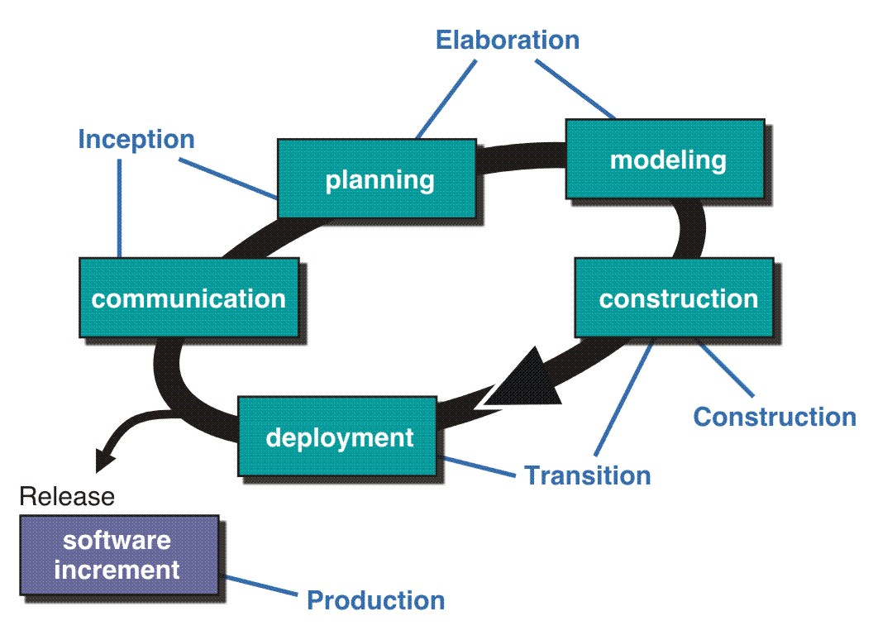
The Unified Process (UP)
inception

Slide 55
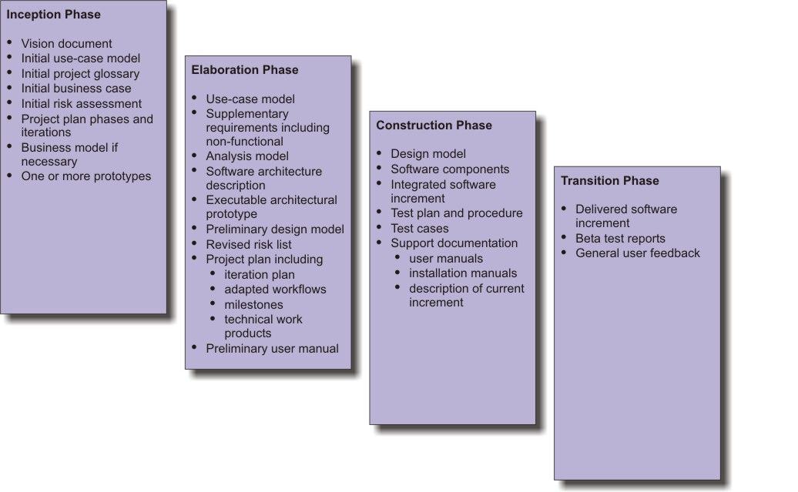
UP Work Products
inception

Slide 56
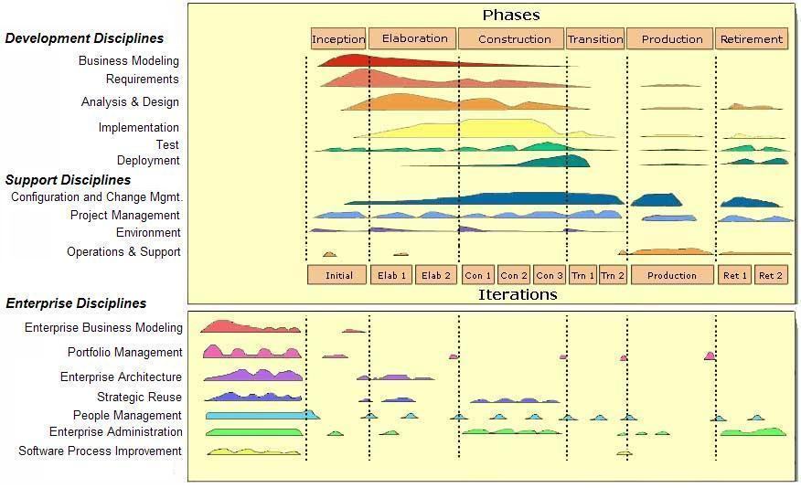
Lifecycle for Enterprise Unified Process
inception

Slide 57
Agile Development

Slide 58
The Manifesto for
Agile Software Development
“We are uncovering better ways of developing software by doing it and helping others do it. Through this work we have come to value:
  Individuals and interactions over processes and tools
  Working software over comprehensive documentation
  Customer collaboration over contract negotiation
  Responding to change over following a plan
That is, while there is value in the items on the right, we value the items on the left more.”
Kent Beck et al

Slide 59
What is “Agility”?
Effective (rapid and adaptive) response to change
Effective communication among all stakeholders
Drawing the customer onto the team
Organizing a team so that it is in control of the work performed
Yielding …
Rapid, incremental delivery of software

Slide 60

Agility and the Cost of Change

Slide 61
An Agile Process
Is driven by customer descriptions of what is required (scenarios)
Recognizes that plans are short-lived
Develops software iteratively with a heavy emphasis on construction activities
Delivers multiple ‘software increments’
Adapts as changes occur
<number>/19

Slide 62
Agility Principles - I
1. Our highest priority is to satisfy the customer through early and continuous delivery of valuable software.
2. Welcome changing requirements, even late in development. Agile processes harness change for the customer's competitive advantage.
3. Deliver working software frequently, from a couple of weeks to a couple of months, with a preference to the shorter timescale.
4. Business people and developers must work together daily throughout the project.
5. Build projects around motivated individuals. Give them the environment and support they need, and trust them to get the job done.
6. The most efficient and effective method of conveying information to and within a development team is face–to–face conversation.
<number>/19

Slide 63
Agility Principles - II
7. Working software is the primary measure of progress.
8. Agile processes promote sustainable development. The sponsors, developers, and users should be able to maintain a constant pace indefinitely.
9. Continuous attention to technical excellence and good design enhances agility.
10. Simplicity – the art of maximizing the amount of work not done – is essential.
11. The best architectures, requirements, and designs emerge from self–organizing teams.
12. At regular intervals, the team reflects on how to become more effective, then tunes and adjusts its behavior accordingly.
<number>/19

Slide 64
Human Factors
the process molds to the needs of the people and team, not the other way around
key traits must exist among the people on an agile team and the team itself:
  Competence.
  Common focus.
  Collaboration.
  Decision-making ability.
  Fuzzy problem-solving ability.
  Mutual trust and respect.
  Self-organization.

Slide 65
Agile Process Models
Extreme Programming (XP)
Adaptive Software Development (ASD)
Dynamic Systems Development Method (DSDM)
Scrum
Crystal
Feature Driven Development (FDD)
Agile Modeling (AM)

Slide 66
Extreme Programming (XP)
The most widely used agile process, originally proposed by Kent Beck
Key activities
  XP Planning
    Begins with the creation of “user stories”
    Agile team assesses each story and assigns a cost
    Stories are grouped to for a deliverable increment
    A commitment is made on delivery date
    After the first increment “project velocity” is used to help define subsequent delivery dates for other increments

Slide 67
Extreme Programming (XP)
XP Design
  Follows the KIS principle
  Encourage the use of CRC cards (see Chapter 8)
  For difficult design problems, suggests the creation of “spike solutions”—a design prototype
  Encourages “refactoring”—an iterative refinement of the internal program design
XP Coding
  Recommends the construction of a unit test for a store before coding commences
  Encourages “pair programming”
XP Testing
  All unit tests are executed daily
  “Acceptance tests” are defined by the customer and excuted to assess customer visible functionality

Slide 68

Extreme Programming (XP)
<number>/19

Slide 69
Adaptive Software Development
Originally proposed by Jim Highsmith
ASD — distinguishing features
  Mission-driven planning
  Component-based focus
  Uses “time-boxing” (See Chapter 24)
  Explicit consideration of risks
  Emphasizes collaboration for requirements gathering
  Emphasizes “learning” throughout the process

Slide 70
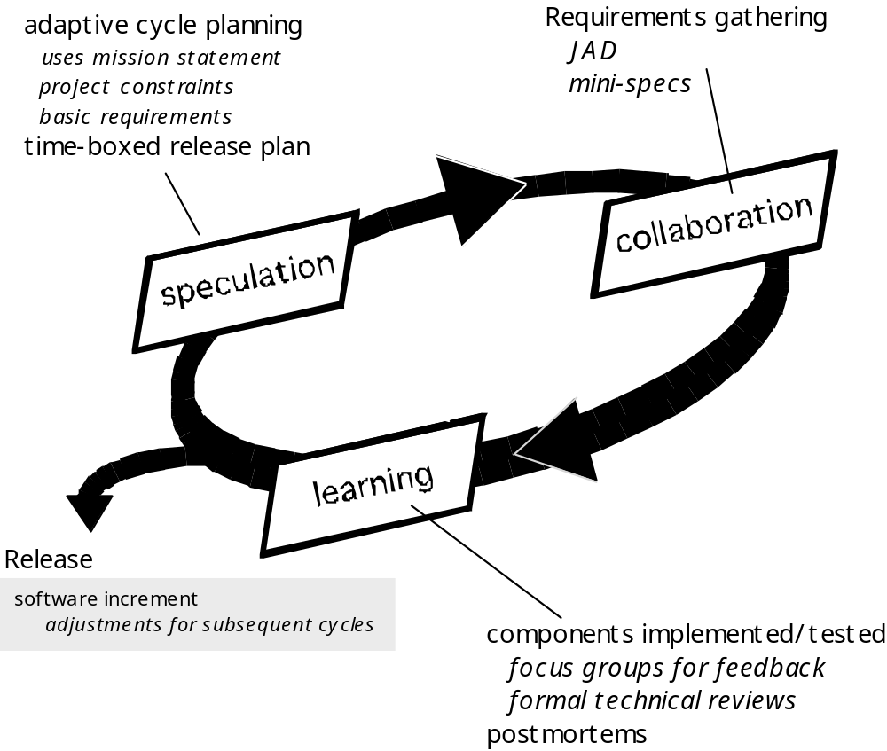
Adaptive Software Development
<number>/19

Slide 71
Dynamic Systems Development Method
Promoted by the DSDM Consortium (www.dsdm.org)
DSDM—distinguishing features
  Similar in most respects to XP and/or ASD
  Nine guiding principles
    Active user involvement is imperative.
    DSDM teams must be empowered to make decisions.
    The focus is on frequent delivery of products.
    Fitness for business purpose is the essential criterion for acceptance of deliverables.
    Iterative and incremental development is necessary to converge on an accurate business solution.
    All changes during development are reversible.
    Requirements are baselined at a high level
    Testing is integrated throughout the life-cycle.

Slide 72
Scrum
Originally proposed by Schwaber and Beedle
Scrum—distinguishing features
  Development work is partitioned into “packets”
  Testing and documentation are on-going as the product is constructed
  Work occurs in “sprints” and is derived from a “backlog” of existing requirements
  Meetings are very short and sometimes conducted without chairs
  “demos” are delivered to the customer with the time-box allocated

Slide 73
Crystal
Proposed by Cockburn and Highsmith
Crystal—distinguishing features
  Actually a family of process models that allow “maneuverability”（机动性） based on problem characteristics
  Face-to-face communication is emphasized
  Suggests the use of “reflection workshops” to review the work habits of the team

Slide 74
Feature Driven Development
Originally proposed by Peter Coad et al
FDD—distinguishing features
  Emphasis is on defining “features”
    a feature “is a client-valued function that can be implemented in two weeks or less.”
  Uses a feature template
    <action> the <result> <by | for | of | to> a(n) <object>
  A features list is created and “plan by feature” is conducted
  Design and construction merge in FDD

Slide 75
Agile Modeling
Originally proposed by Scott Ambler
Suggests a set of agile modeling principles
  Model with a purpose
  Use multiple models
  Travel light
  Content is more important than representation
  Know the models and the tools you use to create them
  Adapt locally

Slide 76
DevOps软件开发模式
（下面内容节选自华为培训资料，版权归华为所有）

Slide 77
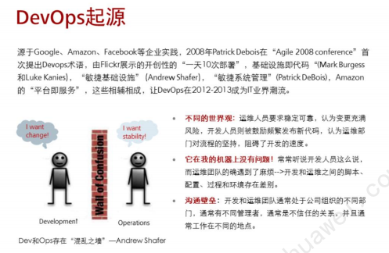

Slide 78
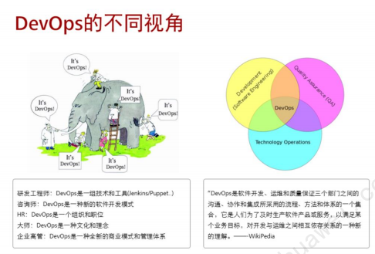

Slide 79
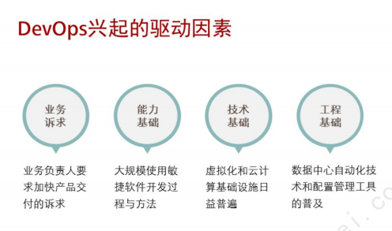

Slide 80
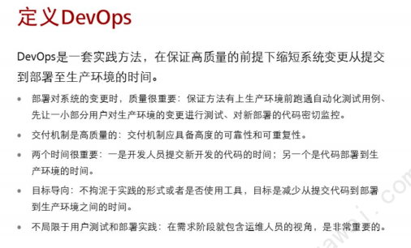

Slide 81
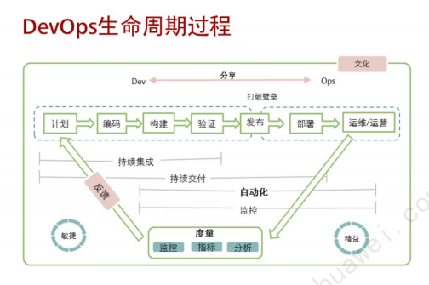

Slide 82
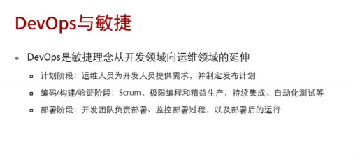

Slide 83
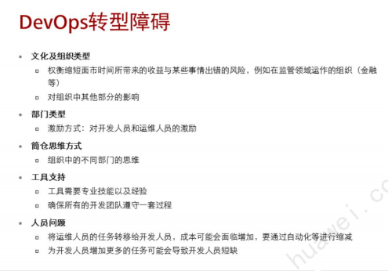

Slide 84
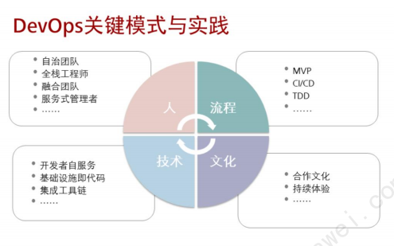
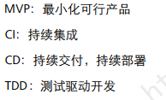

Slide 85
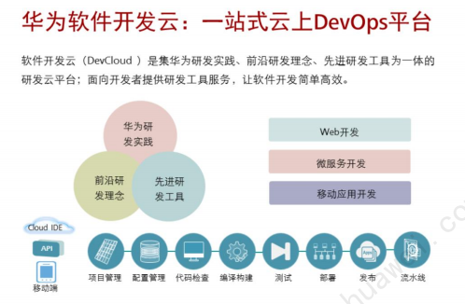

Slide 86

Conclusions
Different life-cycle models
Each with own strengths
Each with own weaknesses
Criteria for deciding on a model include
  The organization
  Its management
  Skills of the employees
  The nature of the product
Best suggestion
  “Mix-and-match” life-cycle model

